Slide 1
64-bit AND
By Jacob Davies

Slide 2
Importance/Instructions
Performs AND logical operation for two 64-bit inputs

Slide 3
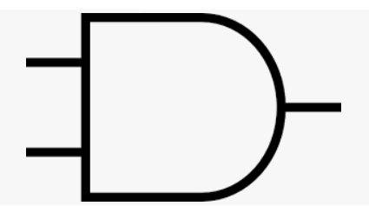
Implementation Overview
Take two 64-bit registers and have it perform bitwise AND operation
A[0]
O[0]
B[0]
64 times, A[n], B[n], O[n]

Slide 4
Test Cases
Example 1: A = 2 (decimal) = 10 (binary)
B = 4 (decimal) = 100
A and B = 000 = 0
Example 2: A = 5 = 101
B = 7 = 111
A and B = 101 = 5

Slide 5
Gate Delay
The bitwise AND happens in parallel so gate delay is only 2

